Slide 1
Valuation of Bank Stock and Bond

Slide 2
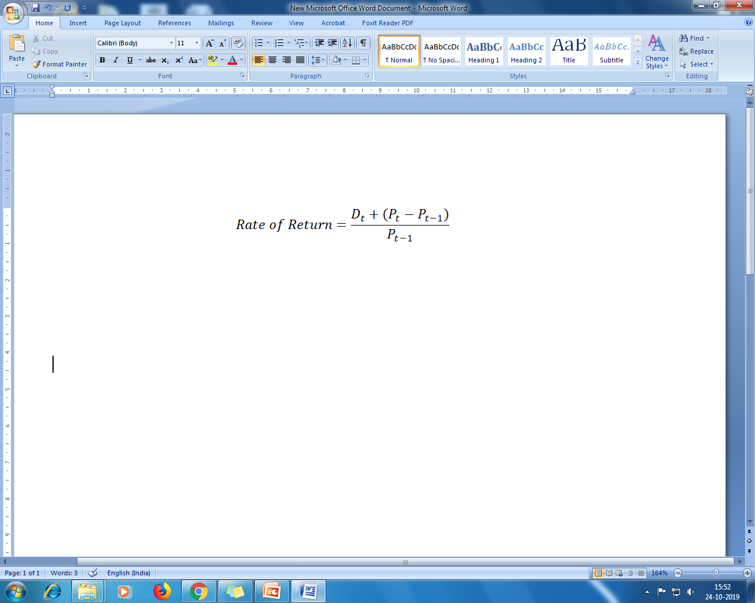
Return of Return of Equity of a Commercial Bank
The rate of return the investor obtains from holding a share of stock for a year or some other period is composed of two parts : (1) the dividend return (D_{t}) and (2) the capital gain in the value of the stock (P_{t-} P_{t-1})
Although returns to investors are determined by dividend payments and price appreciation, the management can control only dividend payments directly.

Slide 3
Inputs for Discounted Cash Flow Models
The value of a share of bank stock is the present value of all future cash flows
Cash flow
The amount of cash flow
The timing of cash flow
The riskiness of cash flow
Growth rate of cash flow: Retention rate * Return on Equity
Discount Rate: Cost of equity, Weighted Average of Cost of Capital
Time period

Slide 4
Cost of Equity and Cost of Capital
Cost of Equity
Risk Free Rate
Market Risk Premium
Market risk (Beta)
Cost of Capital
Weighted average of cost of equity and cost of debt

Slide 5
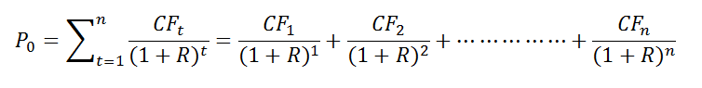
Dividend Discount Model
The value of a share of common stock is the present value of all future cash flow
where P₀ =Current price
CF₁ = Expected cash flow that accrues to the owner of the asset at time t
CF₁ = CF₀(1+g)
g = Rate of growth
R = Required rate of return or discount rate
n = Amount of time the asset is held or expected to be held

Slide 6
Dividend Discount Model Cont..
Three factors will cause an increase in the value of assets:
An increase in the amount of cash flow (i.e., dividends) to be received from the asset
Earlier receipt of the expected cash flow
A decrease in the required rate of return
Three factors will cause a decrease in the value of assets:
A decrease in the amount of cash flow to be received from the asset
Later receipt of the expected cash flow
An increase in the required rate of return

Slide 7
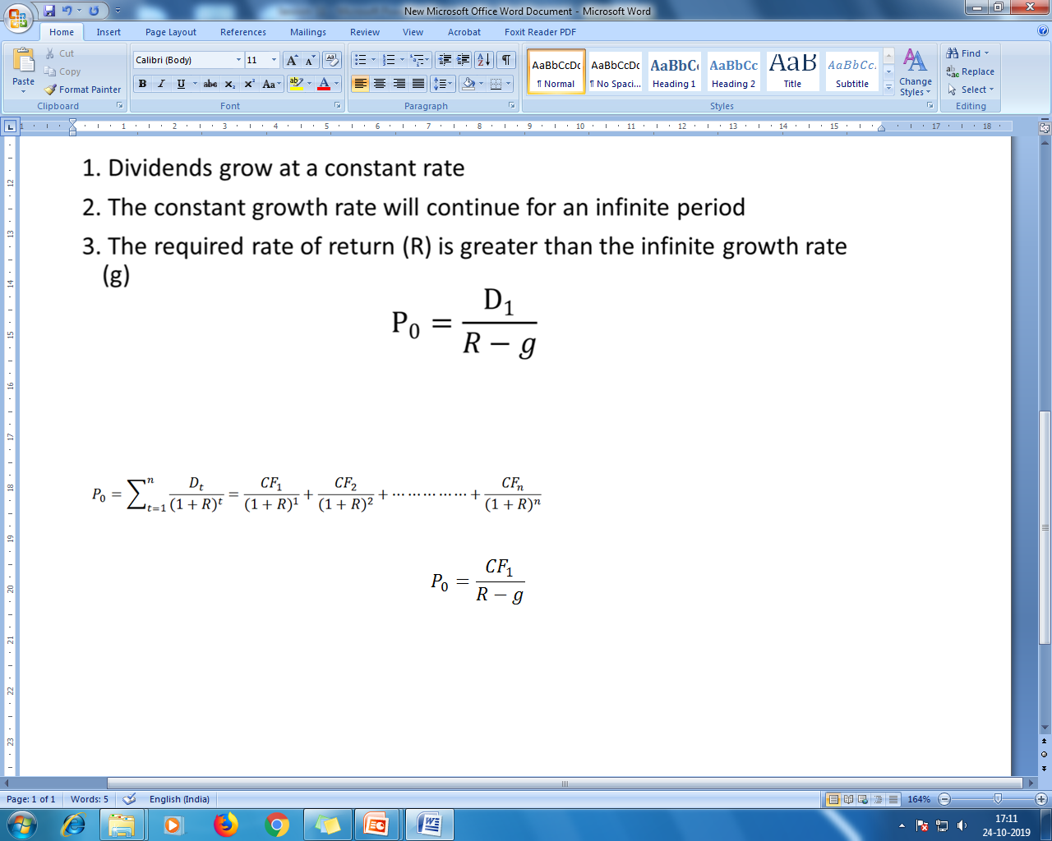
Dividend Growth at Constant Rate: Gordon Growth Model
Cash flows grow at a constant rate
The constant growth rate will continue for infinite period
The required rate of return (R) is greater than the infinite growth rate (g)

Slide 8
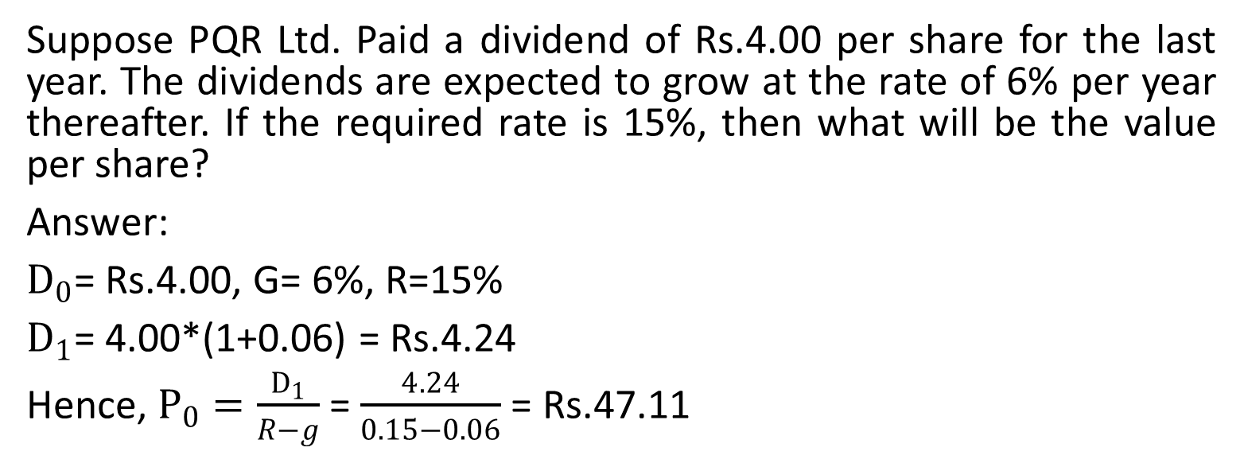
Gordon Growth Model :Example

Slide 9
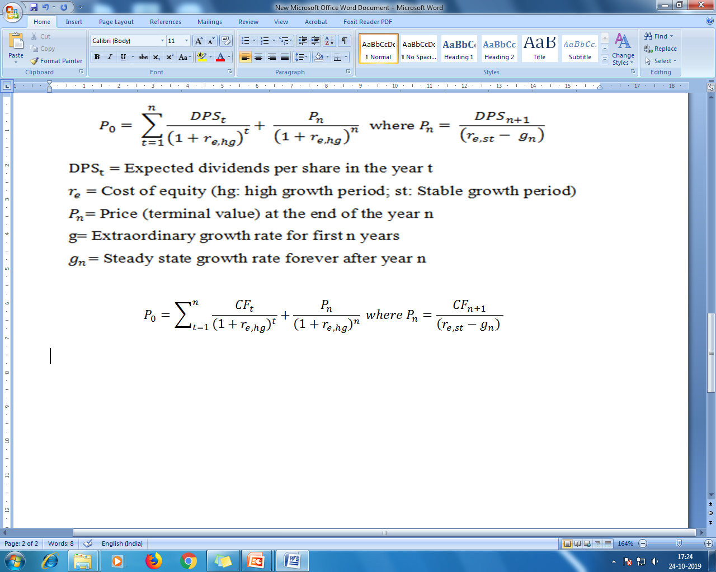
Two Stage Growth Model
It assumes two different growth rates in two different periods i.e. the supernormal growth rate of dividend in the beginning and a stable rate after that for indefinite period.
Value of the stock: Present value of the stock during extra ordinary growth phase + present value of terminal price
where CF₁ = Expected cash flow that accrues to the owner of the asset at time t
r_{e} = Cost of equity (hg: high growth period, st: stable growth period)
P_{n} = Price (terminal) at the end of the year n
g = Extraordinary growth rate for the first n years
r_{e} = Steady state growth rate after year n

Slide 10
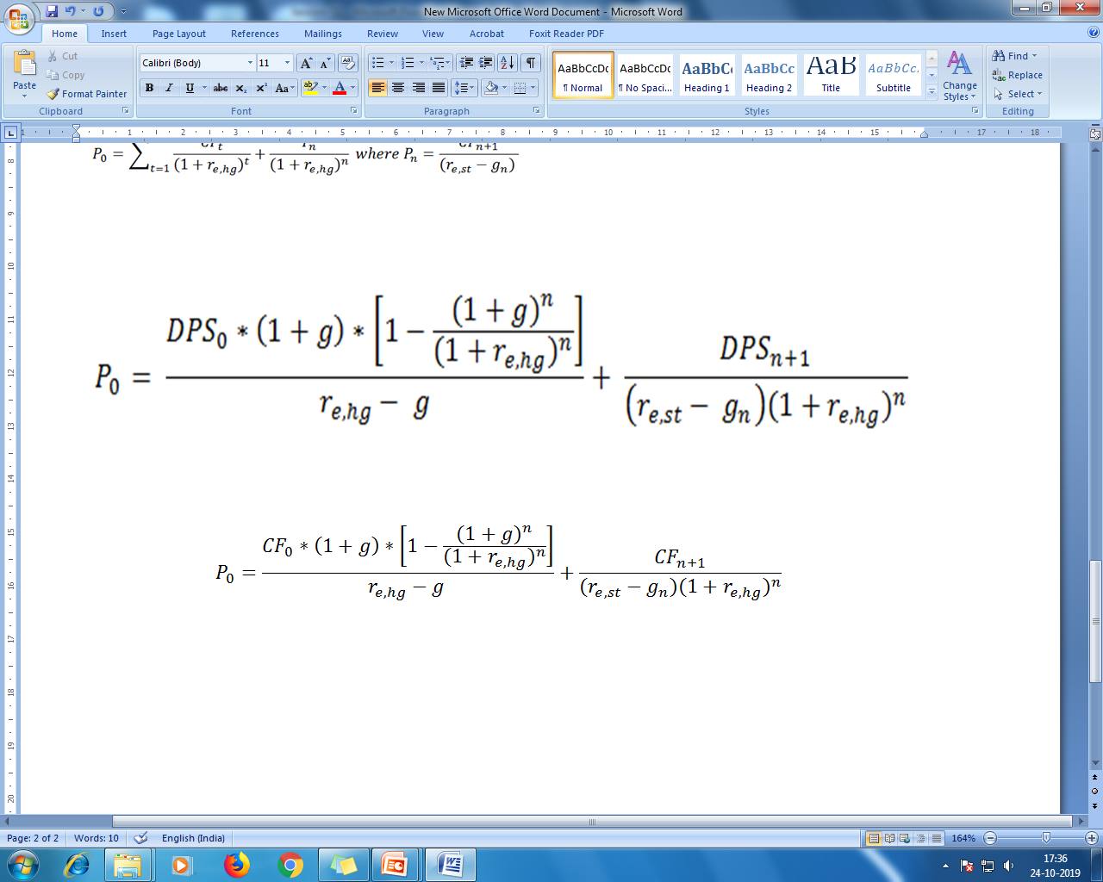
Two Stage Growth Model Cont..
If the growth rate and dividend pay out ratio do not change in the first n years then the formula can be written as:

Slide 11
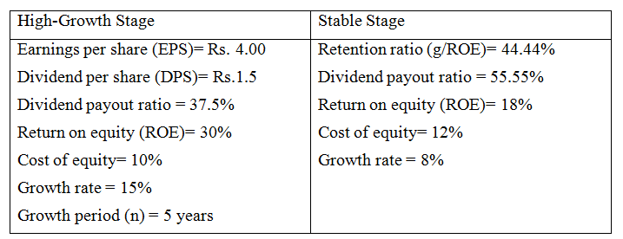
Example: Valuation using Two Stage Dividend Discount Growth Model

Slide 12
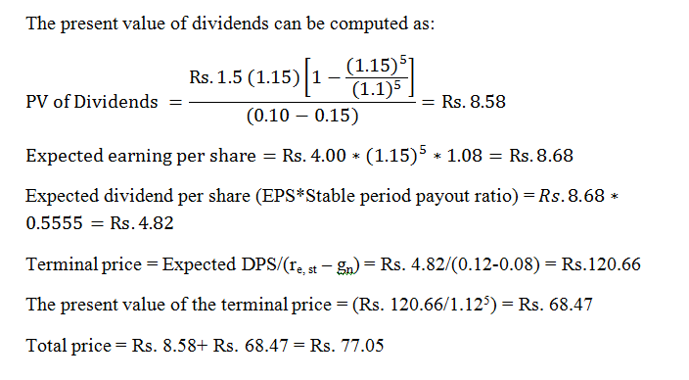
Example: Valuation using Two Stage Dividend Discount Growth Model Cont..

Slide 13
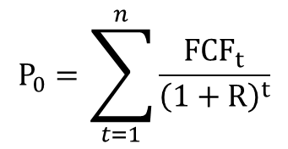
Discounting Free Cash Flow to Equity
Free Cash Flow: Cash flow from operations - capital expenditure + net debt issued
Where:
V_{j} = Value of the stock of firm j
n = number of periods assumed to be infinite
FCF_{t} = the firm’s free cash flow in period t
R = the cost of equity

Slide 14
Discounting Operating Cash Flow
Operating Cash Flows = Net income + Noncash Expenses (Usually Depreciation Expense) + Changes in Working Capital
Where:
V_{j} = value of firm j
n = number of periods assumed to be infinite
OCF_{t} = the firms operating free cash flow in period t
WACC = firm j’s weighted average cost of capital
Where:
OCF₁=operating free cash flow in period 1
g_{OCF} = long-term constant growth of operating free cash flow

Slide 15
Relative Valuation Techniques
Value can be determined by comparing to similar stocks based on relative ratios
Relevant variables include earnings, cash flow, book value, and sales
The most popular relative valuation technique is based on price to earnings

Slide 16
Earnings Multiplier Model
This values the stock based on expected annual earnings
The price earnings (P/E) ratio, or
Earnings Multiplier :
Current Market Price / Earnings per Share
For example, a bank with a market price per share of $45 and earnings per share of $3 has a price-earning ratio of 15 times

Slide 17
Dividend Discount Model and PE Ratio
Dividing both sides by expected earnings (E1)
Thus, the P/E ratio is determined by
1. Expected dividend payout ratio
2. Required rate of return on the stock (k)
3. Expected growth rate of dividends (g)

Slide 18
PE Ratio, Growth and Value Stocks
P/E ratio summarizes the outlook for the future of the bank― the amount of its earnings and dividends, the timings of earnings and dividends, and risk of those earnings and dividends
A bank that is expected to show rapid growth in earnings will have a higher price-earnings ratio
A bank in which earnings are highly variable and unpredictable will tend to have a lower price-earnings ratio
Even if two banks have the same current earnings, their market prices can sharply differ

Slide 19
Use of P/E Ratio
Firms with low P/E ratio are often referred to as value stocks
Return potential is high for value stocks
Firms with high P/E ratio are often referred to as growth stocks
Growth is already realized and return potential is relatively less for growth stocks

Slide 20
Example:
Dividend payout = 50%
Required return = 15%
Expected growth = 10%
D/E = 0.50; k = 0.15; g=0.10
P/E = 0.50 / 0.15-0.10 = 10
A small change in either or both k or g will have a large impact on the multiplier
D/E = 0.50; k=0.16; g=0.10, P/E = 8.33
D/E = 0.50; k=0.15; g=0.11, P/E = 12.5
D/E = 0.50; k=0.14; g=0.11, P/E =16.66

Slide 21
Price to Cash Flow Ratio
Companies can manipulate earnings, and cash-flow is less prone to manipulation
Cash-flow is important for fundamental valuation and in credit analysis
where:
P/CF_{j} = the price/cash flow ratio for firm j
P_{t} = the price of the stock in period t
CF_{t+1} = expected cash low per share for firm j

Slide 22
The Price-Book Value Ratio
Shows the growth opportunity of the company
Study shows an inverse relationship between P/B and stock return
where:
P/BV_{j} = the price/book value for firm j
P_{t} = the end of year stock price for firm j
BV_{t+1} = the estimated end of year book value per share for firm j

Slide 23
The Price-Sales Ratio
Match the stock price with recent annual sales, or future sales
This ratio varies by industry
Relative comparisons using P/S ratio should be between firms in similar industries

Slide 24
Types of Interest Rate
Simple Interest
Interest paid (earned) on only the original amount, or principal, borrowed (lent)
Bank commercial loans may quote simple interest payments
SI= PV*i*n where (i): interest rate, (n) number of period
Compound Interest
Interest paid (earned) on any outstanding principal borrowed (lent) plus interest that has been earned but not paid out
“Interest on interest” – interest earned on reinvestment of previous interest payments
Most bank deposits pay compound interest

Slide 25
Simple Versus Compound Interest Rate
Example 1 i= 12% ; PV = 1000 | SI = $1000*(0.12)*1 =$120 Monthly SI = $1000 * (0.12) * (1/12) = $10
Example 2 Calculate the FV of $1000 invested for 6years at 8% pa
Annual Compounding | Simple Interest
$1000(1.08)⁶=$1,586.87 | Simple interest = $1,000*(.08)*6= $480 Original Principal = $1,000 Future Value = $1,480

Slide 26
Compounding Frequency
The 10% annual rate is the rate with one annualized compounding. With one annualized compounding, we earn 10% every year and $100 would grow to equal $110 after one years:
$100(1.10) = $110
If the simple annual rate were expressed with semi-annual compounding, then we would earn 5% every six months with the interest being reinvested; in this case, $100 would grow to equal $110.25 after one year:
$100(1.05)² = $110.25

Slide 27
Compounding Frequency Cont…
If the rate were expressed with monthly compounding, then we would earn 0.8333% (10%/12) every month with the interest being reinvested; in this case, $100 would grow to equal $110.47 after one year:
$100(1.008333)¹² = $110.47
If we extend the compounding frequency to daily, then we would earn 0.0274% (10%/365) daily, and with the reinvestment of interest, a $100 investment would grow to equal $110.52 after one year:
$100(1+(0.10/365))³⁶⁵ = $110.52

Slide 28
Continuous Compounding
When the compounding becomes large, then we approach towards continuous compounding.
For cases in which there is continuous compounding, the future value (FV) for an investment of A dollars M-years from now becomes:
where e is the natural exponent (equal to the irrational number 2.71828).
Thus, if the 10% simple rate were expressed with continuous compounding, then $100 would grow to equal $110.52 after one year:
$100e^{(.10)(1)} = $110.52

Slide 29
Continuous Compounding
The present value of a future receipt (FV) with continuous compounding is
If R = 0.10, a bond paying $100 two years from now would currently be worth $81.87, given continuous compounding:
PV = $100 e^{-(0.10)(2)} = $81.87
Similarly, a bond paying $100 each year for two years would be currently worth $172.36:

Slide 30
Continuous Compounding
If we assume continuous compounding and a discount rate of 10%, then the value of a 10-year, 9% bond would be:

Slide 31
Bond Concepts
Par Value : Also called the Face Value
Coupon Interest Rate: Borrowers (firms) typically make periodic payments to the bondholders. Coupon rate is the percent of face value paid every year.
Maturity: Time at which the maturity value (Par Value) is paid to the bondholder.
Discount rate: Market interest rate

Slide 32
Bond Value
The value of a bond is the present value of its future cash flow (CF):

Slide 33
Bond Value
Assume the bond makes fixed coupon payments each year and principal at maturity.

Slide 34
Bond Value

Slide 35
Example
10-year, 9% annual coupon bond (9% of par), with F = $1,000 and required return of 10%. What is the value of the bond?

Slide 36
Semi-Annual Coupon Payments
The convention is to quote the required rate as a simple annual interest rate.
When cash flows are semiannual, the convention is to use one-half the simple annual rate as the periodic interest rate to discount the cash flows.
N = number of periods (= (Number of years)(2))
C = Semiannual coupon

Slide 37
Semi-Annual Coupon Payments
10-year, 9% coupon bond, with F=$1,000, required return of 10%, and coupon payments made semiannually.

Slide 38
n-Coupon Payments Per Year
The rule for valuing semi‑annual bonds is easily extended to valuing bonds paying interest even more frequently.
For example, to determine the value of a bond paying interest four times a year, we would quadruple the number of annual periods and quarter the annual coupon payment and discount rate.

Slide 39
n-Coupon Payments Per Year
In general, if we let n be equal to the number of payments per year (i.e., the compounding per year), M be equal to the maturity in years, N = number of periods to maturity = nM, and, as before, R^{A} be the discount rate quoted on an annual basis, then we can express the general formula for valuing a bond as follows:

Slide 40
Effective Rate
The rate that includes the reinvestment of interest (or compounding) is known as the effective rate.
Effective Rate = (1+(R^{A}/n))^{n} – 1
Where, R^{A}= Simple annual rate

Slide 41
Valuation of Zero-Coupon Bond
These type of bonds do not make any periodic coupon payments.
The investor realizes interest as the difference between the maturity value and the purchase price.
These bonds are called zero-discount bonds, zero coupon bonds (also called pure discount bonds (PDB)).

Slide 42
Example
A zero-coupon bond maturing in 10 years and paying a maturing value of $1,000, the required rate is 10%, the value of the bond:
If the convention is to double the number of years and half the annual discount rate i.e. a semi-annual rate of 5%, effective annual rate of 10.25% (= 1.05)² – 1), the value of the bond:

Slide 43
Valuation of Zero-Coupon Bond with Maturity Less than One Year
Let on March 1 a zero coupon bond promising to pay $1000 on September 1 (184 days) and trading at an annual rate of 8%, the value will be:
V= $1000 / (1.08)^{(184/365)} =$96.19
The choice of time measurement used in valuing bonds is known as the day count convention.
The day count convention is defined as the way in which the ratio of the number of days to maturity (or days between dates) to the number of days in the reference period (e.g., year) is calculated.
A day count convention of actual days to maturity to actual days in the year (actual/actual)
A day count convention of 30-day months to maturity to a 360 days in the year (30/360)

Slide 44
Yield to Maturity
YTM is the rate that equates the price of the bond, P₀^{B}, to the PV of the bond’s cash flow (CF); it is similar to the internal rate of return, IRR.
In general, the yield on any investment is the interest rate that will make the present value of the cash flow from the investment equal to the price (or cost) of the investment.
In our first example, if the price of the 10-year, 9% annual coupon bond were priced at $938.55, then we will get its YTM by solving the following equation:

Slide 45
Example
If the price of the 10-year, 9% coupon bond with semi-annual payments with the par value $1000 were priced at $937.69, then its yield will be:

Slide 46
Average Rate to Maturity
Unless the CFs are constant, there is no algebraic solution to finding the YTM. The YTM is found through an iterative process (trial and error).
The YTM can be estimated using the ARTM (also referred to as the yield approximation formula):

Slide 47
Example
The ARTM for the 9%, 10‑year bond with annual payments trading at $938.55 is:
The semi-annual ARTM for the 9%, 10‑year bond with semi-annual payments and trading at $937.69 is:

Slide 48
Inverse relation between bond price (value) and rate of return

Slide 49
Price-Yield Curve
It depicts the inverse relation between V and R. The Price-Yield curve for the 10-year, 9% coupon bond, Face value: $1000

Slide 50
The greater a bond’s maturity, the greater its price sensitivity to interest rate changes
Investors will realize greater capital gains and capital losses on long-term securities than on short term securities when interest rate changes by the same amount

Slide 51
Example: Effect of Maturity on Bond Price Volatility
Par value: $1000, Coupon= 8 %, Maturity: 7 & 10 Years
Term to Maturity | 1 year |  | 10 years |  | 20 years |  | 30years
Discount Rate (YTM) | 7% | 10% | 7% | 10% | 7% | 10% | 7% | 10%
Present Value of Interest | $75 | $73 | $569 | $498 | $858 | $686 | $1005 | $757
Present Value of Principal | 934 | 907 | 505 | 377 | 257 | 142 | 132 | 54
Total Value of Bond | $1009 | $980 | $1074 | $875 | $1115 | $828 | $1137 | $811
Percentage change in total value | -2.9 |  | -18.5 |  | -25.7 |  | -28.7

Slide 52
The smaller a bond’s coupon rate, the greater its price sensitivity to interest rate changes

Slide 53
Example: Effect of Coupon on Bond Price Volatility
Present value of 20 year bond ($1,000 par value)
 | 0% (Coupon) |  | 3% (Coupon) |  | 8% (Coupon) |  | 12% (Coupon)
Discount Rate (YTM) | 7% | 10% | 7% | 10% | 7% | 10% | 7% | 10%
Present Value of Interest | $0 | $0 | $322 | $257 | $858 | $686 | $1287 | $1030
Present Value of Principal | 257 | 142 | 257 | 142 | 257 | 142 | 257 | 142
Total Value of Bond | $257 | $142 | $579 | $399 | $1115 | $828 | $1544 | $1172
Percentage change in total value | -44.7 |  | -31.1 |  | -25.7 |  | -24.1

Slide 54
Bond Price and Interest Rate
For a specific absolute change in interest rates, the proportionate increase in bond prices when rates fall exceeds the proportionate decrease in bond prices when rates rise.
The proportionate difference increases with maturity and is larger the lower a bond’s periodic interest payment
For the identical absolute change in interest rates, a bondholder will realize greater capital gain when rates decline than capital loss when rates increase

Slide 55
Example: Effect of Yield Level on Bond Price Volatility
Present value of 20 year bond, 4 percent ($1,000 par value)
 | (1) |  | (2) |  | (3) |  | (4)
Discount Rate (YTM) | 3% | 4% | 6% | 8% | 9% | 12% | 9% | 10%
Present Value of Interest | $602 | $547 | $462 | $396 | $370 | $301 | $370 | $343
Present Value of Principal | 562 | 453 | 307 | 208 | 175 | 97 | 175 | 142
Total Value of Bond | $1164 | $1000 | $769 | $604 | $545 | $398 | $545 | $485
Percentage change in total value | -14.1 |  | -21.5 |  | -27.0 |  | -11.0

Slide 56
Relation between coupon rate, required rate (discount rate), bond value (price), and face value (principal)

Slide 57
Total Return
The total return (also call the realized yield) is a measure of the yield obtained by assuming the cash flows are to be reinvested to the investor’s horizon (HD) at an assumed reinvestment rate and at the horizon the bond is sold at an assumed rate given the horizon is not at maturity.
The total return is determined by
Estimating the horizon value, total monetary return and bond price at the horizon
Given the current price or value and the horizon value, solving for the rate (similar to the way one solve for the rate on a zero-coupon bond)

Slide 58
Example
Suppose an investor buys a 4‑year, 9% coupon bond, paying coupons annually, market interest rate 10% and a par value of $1,000. Assume the investor needs cash at the end of year 3 (HD = 3), is certain he can reinvest the coupons during the period in securities yielding 10%, and expects to sell the bond at his HD at a rate of 10%.
To determine the investor's TR, we first need to find the HD value. This value is equal to the price the investor obtains from selling the bond at HD and the value of the coupons at the HD.

Slide 59
Example Cont….
Price of the Bond = $968.30
In this case, the investor, at his HD, will be able to sell a one‑year bond paying a $90 coupon and a $1,000 at maturity for $990.91, given the assumed discount rate of 10%
The $90 coupon paid at the end of the first year will be worth $108.9, given the assumption it can be reinvested at 10% for two years and there is annual compounding, $90(1.10)² = $108.9
The $90 received at the end of year two will, in turn, be worth $99 in cash at the HD, $90(1.10) = $99
The investor would receive his third coupon of $90
Combined, the investor would have $1288.81 in cash at the HD: HD value = $1288.81
The horizon value of $1288.81 consists of a bond valued at $990.91, coupons of $270, and interest earned from reinvesting coupons of $27.9

Slide 60
Example Cont….
Given the HD value of $1,288.81, the TR is found in the same way as the YTM for a zero-coupon bond.

Slide 61
Duration
A bond's duration (D) can be defined as the weighted average of the bond's time periods, with the weights being each time period's relative present value of its cash flow
It is the weighted average on a present value basis of the time to full recovery of the principal and interest payments on a bond. It measures the weighted average maturity of a bond’s cash flows on a present value basis.

Slide 62
Duration Cont..
It is a measure of effective maturity that incorporates the timing and size of a security’s cash flows.
It captures the combined impact of market rate, size of interim payments and maturity on a security’s price volatility
Conceptually, duration is a measure of interest elasticity in determining a security’s market value.
Thus if a security’s duration is known, an investor can readily estimate the size of a change in value (or price) for different rate changes

Slide 63
Example
Find out the duration of a 4‑year, 9% annual coupon bond with par value $1000 given a flat yield curve at 10%
t | CF_{t} | CF_{t}/(1.10)^{t} | PV(CF_{t})/P^{B} | t[PV(CF_{t})/P^{B}]
1 2 3 4 | 90 90 90 1090 | 81.818 74.380 67.618 744.485 P^{B} = 968.30 | .084496 .076815 .069832 .768857 | 0.084496 0.153630 0.209496 3.075428 D = 3.52

Slide 64
Duration of a Bond Portfolio
The duration of a bond portfolio, D_{p}, is simply the weighted average of each of the bond's durations (D_{i}), with the weights being the proportion of investment funds allocated to each bond (w_{i}):

Slide 65
Duration as a Price Sensitivity Measure
Though duration is defined as the weighted average of a bond's time periods, it is also an important measure of volatility.
As a measure of volatility, duration is defined as the percentage change in a bond's price (%ΔP = ΔP/P₀) given a small change in yield, dy.
Mathematically, duration is obtained by taking the derivative of the equation for the price of a bond with respect to the yield, then dividing by the bond's price and expressing the resulting equation in absolute value.

Slide 66
Duration as a Price Sensitivity Measure Cont…
dP/P₀ = percentage change in the bond's price
dy = small change in yield
N = number of periods to maturity (M)
The bracketed expression is the weighted average of the time periods, defined in the last section as duration.
Formally, the weighted average of the time periods is called Macaulay's duration, and the equation, which defines the percentage change in the bond's price for a small change in yield in absolute value, is called the modified duration.

Slide 67
Duration as a Price Sensitivity Measure Cont…
Note that the price of a bond that pays coupons each period and its principal at maturity is
Taking the first derivative of this equation, dividing through by P, and expressing the resulting equation in absolute value provides a measure of duration for a bond paying principal at maturity:

Slide 68
Duration as a Price Sensitivity Measure Cont…
The above measures of duration are defined in terms of the length of the period between payments.
Thus, if the cash flow is distributed annually, duration reflects years; if cash flow is semi-annual, then duration reflects half years.
The convention is to express duration as an annual measure.
Annualized duration is obtained by dividing duration by the number of payments per year (n):

Slide 69
Properties of Duration
The lower the coupon rate, the greater the duration.
The longer the terms to maturity, the greater the duration.
For zero-coupon bonds, Macaulay’s duration is equal to the bond’s term to maturity (N) and the modified duration is equal N/(1+y).
The higher the yield to maturity, the lower the duration.

Slide 70
Factors Affecting Bond Returns
Credit Rating
Maturity
Size
Liquidity
Downside risk
Credit quality
Market risk

